Slide 1
LIMITING IMPERVIOUS SURFACE COVERAGE USING POROUS TECHNOLOGIES
Presented By:
RICHARD L. SNYDER, CPESC
RESOURCE CONSERVATIONIST
DAUPHIN COUNTY CONSERVATION DISTRICT

Slide 2
“Financial and Other Support for this Project is Provided by the Pennsylvania Association of Conservation Districts, Inc. Through a Grant from the Pennsylvania Department of Environmental Protection Under Section 319 of the Clean Water Act, Administered by the U.S. Environmental Protection Agency.”

Slide 3
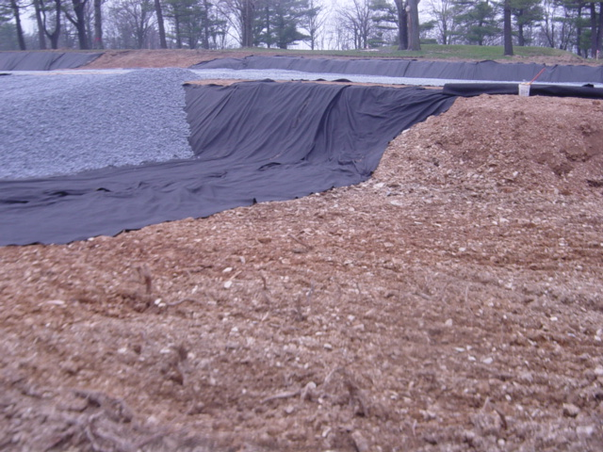
WHAT IS PERVIOUS PAVEMENT?
PERMEABLE SURFACE COURSE
Bituminous Asphalt
Concrete
Paver Blocks
Reinforced Turf and Gravel Filled Grids
AASHTO #57 CHOKER COURSE
CLEAN, UNIFORMLY-GRADED STONE BED
AASHTO #3
Minimum Void Space of 40%
Depth Varies – Generally 12” to 36”
NON-WOVEN GEOTEXTILE
UNCOMPACTED SUBGRADE

Slide 4
POtEnTIal applications
RESIDENTIAL (LIMITED)
COMMERCIAL
ULTRA URBAN
INDUSTRIAL
RETROFIT
HIGHWAY / ROAD (LIMITED)

Slide 5
STORMWATER FUNCTIONS
VOLUME REDUCTION = MEDIUM
RECHARGE = MEDIUM
PEAK RATE CONTROL = MEDIUM
WATER QUALITY = MEDIUM
TSS = 85%
TP = 85%
N02 = 30%

Slide 6
dEtAIled stORmwater functions
VOLUME REDUCTION
Volume = Depth (ft) x Area (sf) x Void Space
Infiltration Volume = Bed Bottom Area (sf) x Infiltration Rate (in/hr) x Infiltration Period (hr) x 1/12
PEAK RATE MITIGATION
WATER QUALITY IMPROVEMENT

Slide 7
KEY DESIGN ELEMENTS
PERVIOUS PAVEMENT
Primarily for Peak Rate Control
Does NOT Address Water Quantity and / or Water Quality
Storage is Short Duration
Primary Use(s) is Rapidly Restored
Minimize Safety Risks / Potential Property Damage / User Inconveniences
Emergency Overflows
Maximum Ponding Depths
Flow Control Structures
Adequate Surface Slope to Outlet
INFILTRATION BED
Minimum 2’ of Renovating Soil
Maximum Loading Ratio of 5:1 (Impervious Area:Infiltration Area)
Natural, Uncompacted Soils with an Acceptable Infiltration Capacity
Filled with Stone (or Alternative)
Wrapped in Non-Woven Geotextile
Nearly Level to Level Bottoms
Positive Stormwater Overflow
Protection from Sedimentation
Perforated Pipe Network Along the Bottom for Distribution
Open-Graded, Clean Stone with a Minimum 40% Void Space

Slide 8
VARIATIONS / TYPES OF POROUS TECHNOLOGIES
BITUMINOUS ASPHALT
Fines Screened / Reduced
Single 3.5” Lift, Lightly Rolled to a Finished Depth of 2.5”
CONCRETE
Reduced Number of Fines
Coarser Appearance
PAVER BLOCKS
Interlocking Units Filled with a Pervious Material
Attractiveness / Aesthetics
REINFORCED TURF AND GRAVEL FILLED GRIDS
Interlocking Structural Units, Containing Voids for Turf Grass Growth / Gravel
Suitable for Both Traffic Loads and Parking
Underlain by a Stone and / or Sand Drainage System

Slide 9
DESIGN CONSIDERATIONS
EVALUATION FOR USE SHALL OCCUR EARLY IN THE DESIGN PROCESS
ORIENTATION OF PARKING BAYS ALONG EXISTING CONTOURS
Significantly Reduces the Need for Cut / Fill
DO NOT PLACE ON RECENT FILL AND / OR COMPACTED FILL
Grade Adjustments shall be Done with Stone Subbase Material
DO NOT COMPACT BED BOTTOM
STONE SUBBASE MATERIAL PLACED IN LIFTS, AND LIGHTLY ROLLED
STONE BED MAY BE USED AS A SEDIMENT BASIN / TRAP
Reduces Overall Site Disturbance
12” Buffer Between Sediment Basin / Trap Bottom and Final Bed Bottom Elevation
Sediment shall be Removed as Part of Sediment Basin / Trap Conversion

Slide 10
DESIGN CONSIDERATIONS (CONT.)
NEARLY LEVEL TO LEVEL BED BOTTOM
Sloped Bed Bottom Creates Both Ponding and Reduced Distribution
OVERFLOW SYSTEM
Inlet Boxes are Cost-Effective Overflow Structures
ABLE TO CONVEY / MITIGATE PEAK RUNOFF FROM LESS-FREQUENT, MORE-INTENSE STORMS
Outlet Control Structure (i.e. Modified Inlet Box with Both an Internal Weir and a Low-Flow Orifice)
Specific Design will Vary
BOTH STONE BED AND OVERFLOW SYSTEM MAY BE DESIGNED / EVALUATED SIMILAR TO A DETENTION BASIN
Demonstrates Mitigation of Peak Runoff

Slide 11
DESIGN CONSIDERATIONS (CONT.)
INTERNAL WEIR WITHIN AN INLET BOX / OVERFLOW STRUCTURE
Maximizes Water Level in Stone Bed
Provides Sufficient Cover for Overflow System
PERFORATED PIPES ALONG BED BOTTOM
Evenly Distribute Runoff Over Entire Bed Bottom
Connect Appurtenant Structures (i.e. Cleanouts, Inlets Boxes, Etc.)
Lay Flat Along Bed Bottom
May Provide Additional Storage Volume
ROOF LEADERS / AREA INLETS MAY BE CONNECTED
Pre-Treatment is Recommended
LOCATED WITHIN IMMEDIATE PROJECT AREA
EROSION AND SEDIMENTATION CONTROL IS CRITICAL
Surface Sediment Removed Via Vacuum Sweeper
Do NOT Power-Wash Surface Sediment into Stone Bed

Slide 12
DEsIGn consideRAtions (cont.)
STONE BED PLACED ON A SLOPE
Benching / Terracing
STONE BED
12” to 36” Deep
Clean, Uniformly-Graded AASHTO #3 with Approximately 40% Void Space
Sized to Mitigate Increased Runoff Volume from a 2-Year / 24-Hour Storm
ALTERNATIVE SUBSURFACE STORAGE PRODUCTS
Proprietary, Interlocking Plastic Units
Greater Storage Capacity than AASHTO #3
Increased Cost
BACK-UP METHOD FOR RUNOFF TO ENTER STONE BED
Uncurbed Lots – Unpaved 2’ Wide Stone Edge Drain
Curbed Lots – Inlets with Pre-Treatment Devices

Slide 13
DEsIgn considerations (cont.)
STONE BED MAY BE DESIGNED TO SLOWLY DISCHARGE TO ADJACENT WETLANDS AND / OR BIORETENTION AREAS
Areas with Poorly Draining Soils
STONE BED LINED TO PREVENT INFILTRATION
Industrial Sites with Contaminated Soils
PRE-TREATMENT DEVICES
Threat of Spills and / or Groundwater Contamination
SEAL COATING AND / OR OVERPAVING
Lack of Awareness

Slide 14
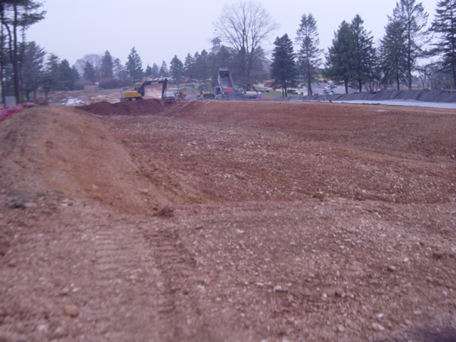
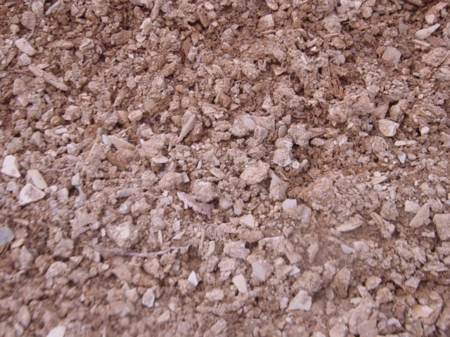
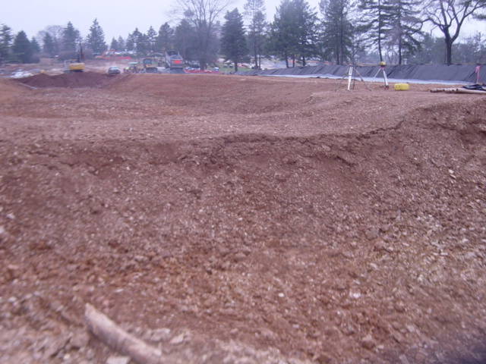
CONSTRUCTION SEQUENCE
INSTALLATION / CONSTRUCTION SHALL BE NEAR THE END
STONE BED EXCAVATED TO FINAL GRADE
DO NOT COMPACT EXISTING SUBGRADE
UNWANTED FINES / SATURATED SOILS REMOVED WITH LIGHT EQUIPMENT, THEN SCARIFIED 6” MINIMUM
EARTHEN BERMS INSTALLED / CONSTRUCTED
GEOTEXTILE PLACED
Adjacent Strips Overlap 16” Minimum
Secured 4’ Minimum Outside of Stone Bed
STONE BED PLACED
8” Lifts and Lightly Compacted
Topped with a Choker Base Course (1+” AASHTO #57)
POROUS TECHNOLOGY INSTALLED
Full Permeability Tested by Applying CLEAN Water at 5gpm

Slide 15
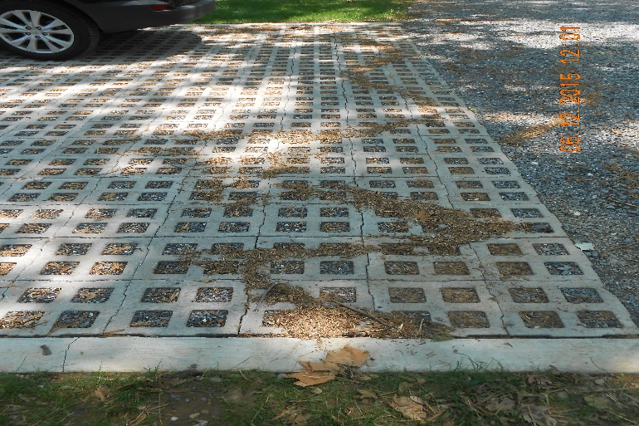
LONG-TERM OPERATION AND MAINTENANCE
PRIMARY GOAL = TO PREVENT CLOGGING BY FINES
VACUUMED BIANNUALLY WITH COMMERCIAL CLEANING UNITS
Pavement Washing Systems / Compressed Air Units are NOT Recommended
TRIBUTARY INLET BOXES CLEANED BIANNUALLY
ADJACENT VEGETATED / LANDSCAPED AREAS MAINTAINED SEMIANNUALLY
TRASH / LITTER / DEPOSITED SOIL REMOVED, PROPERLY DISPOSED
SPECIAL MAINTENANCE CONSIDERATIONS
Winter Maintenance
Repairs (i.e. Potholes, Settling, Etc.)
NO, NO, NO…Seal Coating

Slide 16
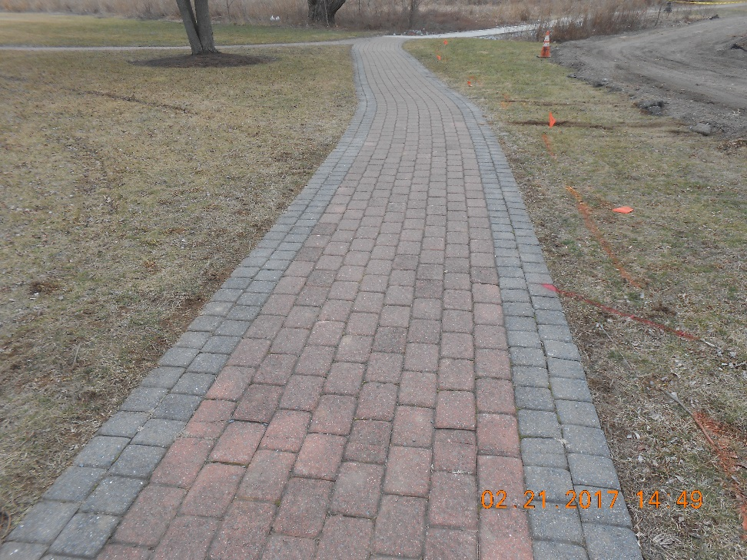
COST ISSUES
PERVIOUS ASPHALT
10% to 20% Higher than Standard Asphalt per Unit Area
Appropriate Comparison??
PERVIOUS CONCRETE
More Expensive than Pervious Asphalt
Increased Labor / Installation Experience
PERMEABLE INTERLOCKING CONCRETE PAVEMENT BLOCKS
Varies by Type / Manufacturer
$2,000 TO $2,500 / PARKING SPACE (2005)

Slide 17
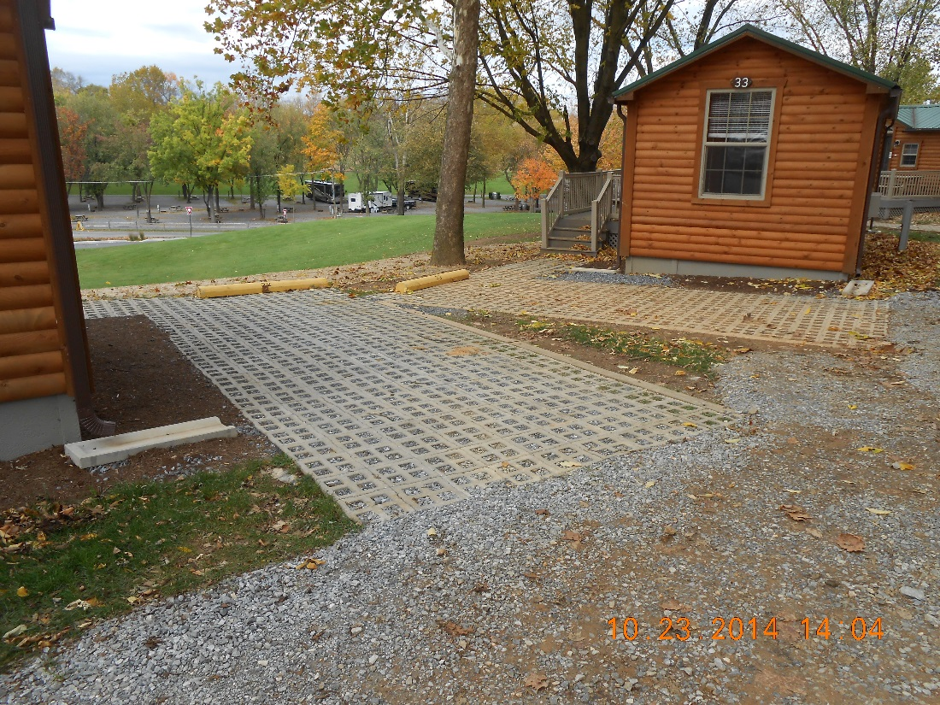
Q&A / PROGRAM EVALUATION

